Slide 1
What’s new in Office 365 Malavika Rewari Microsoft 365 Marketing Anita Mortaloni Office 365 Engineering

Slide 2






Thank you all for pushing the boundaries of productivity and inclusion with Office 365, enabling transformative change
Andrew, a young boy who read for the first time with Learning Tools.
Justin, a young man who uses Office 365 to communicate with the world.
Veronica, a student with low vision who created a perfect Sway.
Cameron, a lecturer who believes its an exciting time to be blind with Office 365 facilitating collaboration.
Jack, a teacher who shows students what is possible with Office 365 and Narrator.
Steve, who navigated a medical crisis with OneNote and Office Lens to access printed documents.

Slide 3
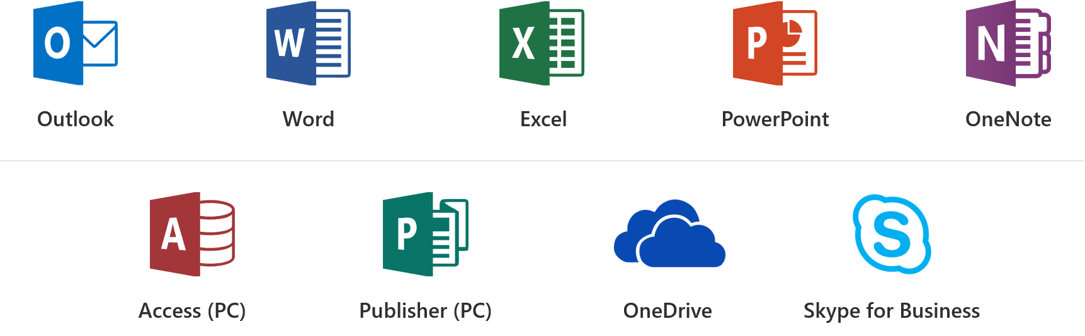
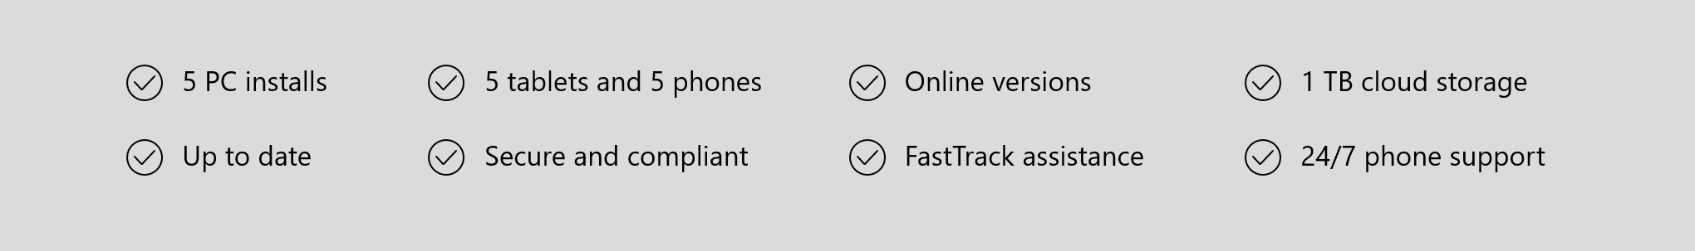
Office 365 ProPlus Overview

Slide 4
Office 365 is designed to boost productivity for people of all abilities and enable inclusive communications
Consume Content Independently
Create Confidently
Collaborate Inclusively
Organize Efficiently

Slide 5
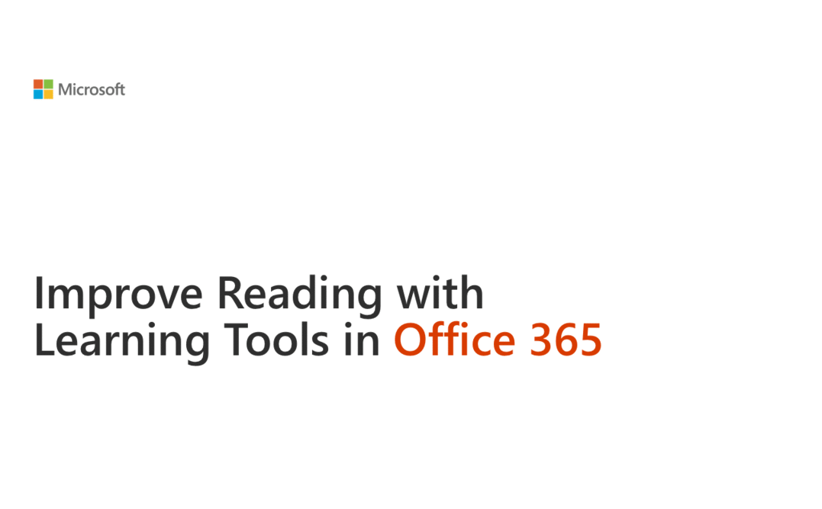
Consume Content Independently
Ease of Access Settings
Screen Reader and Keyboard
Learning Tools
Notes:
Ease of Access Settings in Windows 10—Allow the user to personalize their PC and how they access content to better meet their vision, mobility, hearing or learning needs. Over the last year, a lot of thought and effort has gone into improving the productivity experiences when ease of access settings are enabled. For example, Office 365 usability in high contrast mode has been significantly enhanced, improving the user’s experience through bolder colors, cleaner graphics and increased usability with shapes and charts.
Screen reader and keyboard navigation Keyboard shortcuts and screen readers make Office apps accessible to users with low or no vision. Aka.ms/OfficeAccessibility outlines how various Office 365 apps can be used efficiently with screen readers and keyboards
Learning Tools are free tools that implement proven techniques to improve reading and writing for people regardless of their age or ability. They include tools that read text out loud, break it into syllables, and increase spacing between lines and letters. They are built into Word, OneNote, Outlook and more. Learn more at https://www.onenote.com/learningtools

Slide 6

Andrew’s Story
“Andrew, in that moment, conquered this fear and realized that he could access something that had been inaccessible to him, and I saw my little boy read and knew that here was an answer, that here was something that could change his life.”
Andrew is a student with dyslexia who read for the first time before entering third grade with the aid of Learning Tools in OneNote.

Slide 7
Learning Tools availability in Office 365
Capability | Availability
Read aloud with simultaneous highlighting | OneNote 2016 (add-in), OneNote Online, OneNote for Windows 10 and OneNote for iPad Word 2016, Word Online and Word for iOS Outlook 2016 and Outlook Web Access Office Lens on iOS
Adjustable text spacing and font size | OneNote 2016 (add-in), OneNote Online, OneNote for Windows 10 and OneNote for iPad Word 2016, Word Online and Word for iPad Outlook Web Access Office Lens on iOS
Syllabification | OneNote 2016 (add-in), OneNote Online, OneNote for Windows 10 and OneNote for iPad Word 2016 and Word Online Outlook Web Access
Parts of speech identification | OneNote Online, OneNote for Windows 10 and OneNote for iPad Word Online Outlook Web Access
Line focus mode | OneNote Online, OneNote for Windows 10 and OneNote for iPad Word Online Outlook Web Access

Slide 8
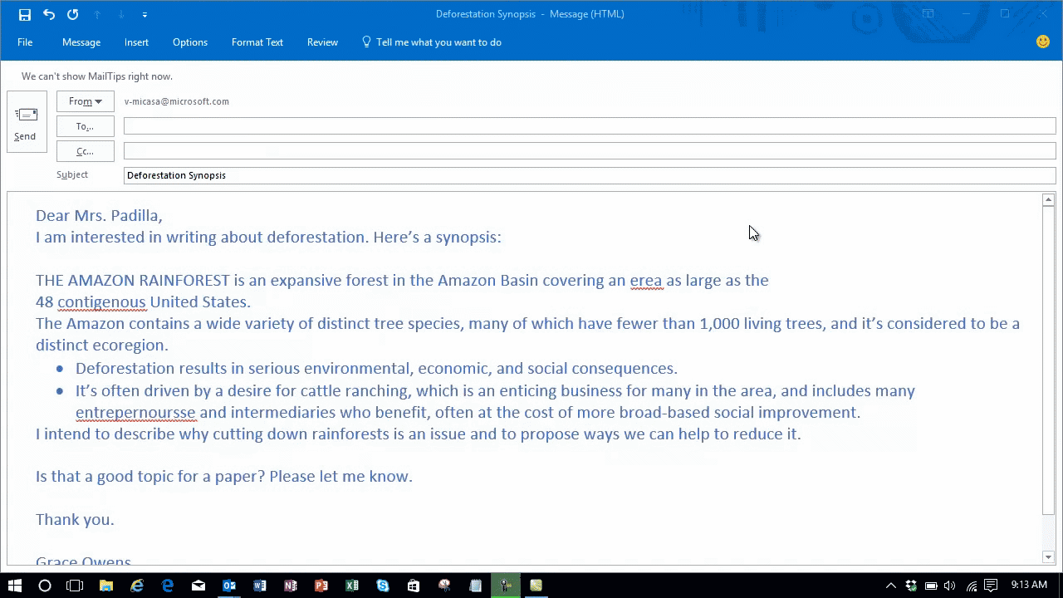
Create Confidently
Tell Me
Dictate
Editor and Read Aloud
Notes:
People who use screen readers struggle trying to get around the computer efficiently without using too many steps and clicks. The “Tell me what you want to do” feature in Office makes this efficient. To activate the feature, you can either click Tell Me on the ribbon in Office 2016 and Office Online or use the keyboard shortcut Alt+Q and type in what you need. For example, if you want to start researching a topic, just type in “Researcher” and it will take you to the feature you want within the Office application. Learn more about Tell Me at https://blogs.office.com/2014/05/15/get-more-done-with-tell-me/
Editor checks your document or email message for spelling and grammar errors, and makes suggestions for writing style. Suggestions are based on the context of your writing, using machine learning and natural language processing. It is inclusively designed and easy for people with learning and visual impairments to use. Learn more at aka.ms/Editor

Slide 9
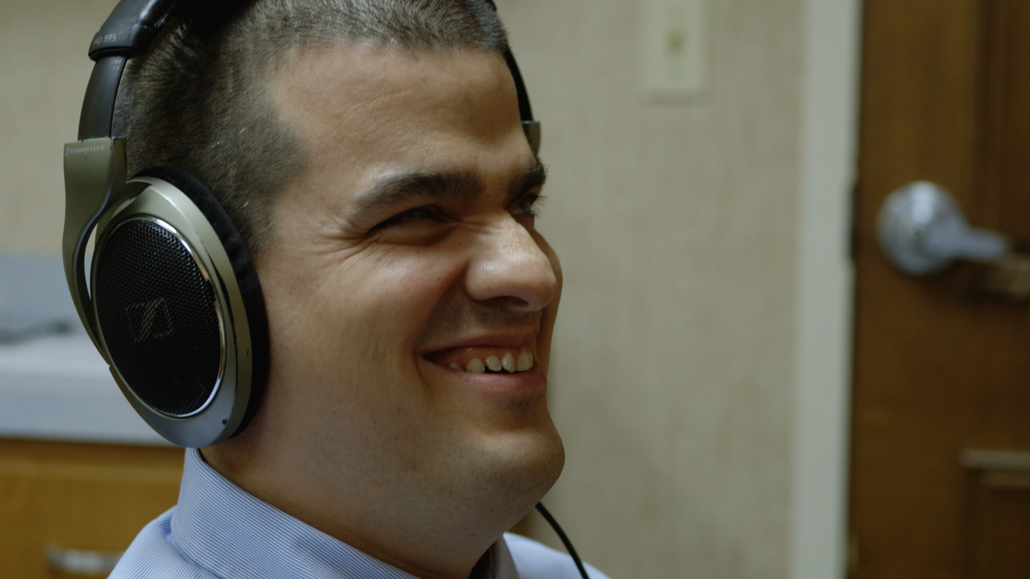
Jack’s Story
"I can now open up Excel or PowerPoint or Word and I can produce content that someone across the world would look at and never know a blind person had a role in that production."
Jack is the Director of Technology at the Louisiana Center for the Blind. He teaches his students how to create high-quality visual content with Microsoft Office 365 and Windows 10.

Slide 10
Writing and Proofing Tools in Office 365
Capability | Availability
Dictation | OneNote 2016, OneNote for Windows 10 Word 2016 Outlook 2016 PowerPoint 2016
Spelling suggestions for phonetic misspellings | Word 2016, Word Online and Word for Mac Outlook 2016
Synonyms alongside spelling suggestions that can be read aloud | Word 2016 Outlook 2016
Grammar checks | Word 2016, Word Online and Word for Mac Outlook 2016
Customizable writing critiques | Word 2016 and Word for Mac Outlook 2016
Tell me what you want to do | Office 2016 Office Online Office on iOS, Android and Windows 10

Slide 11
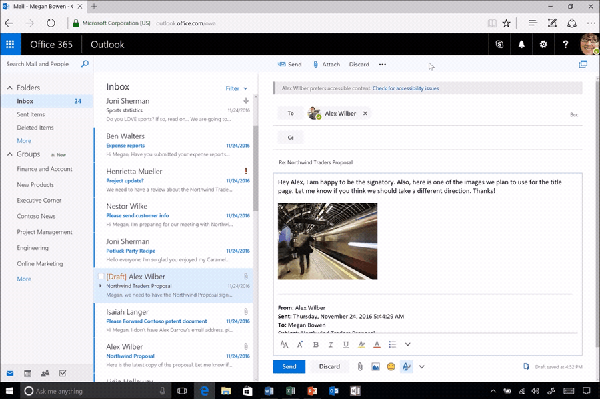
Collaborate Inclusively
Accessibility Checker
Accessible Templates
Automatic Alt Text and Subtitles
Notes:
As you communicate, it is important to meet the diverse needs of your audience. Making your content accessible ensures it can be used without barriers by people with varying levels of vision, hearing, cognition and mobility.
Noteworthy new capabilities built into Office 365 to help you with this include:
Accessibility checker—Before sharing content, you can run the accessibility checker to find and fix any issues that might make your content difficult for people with disabilities to use. The accessibility checker is now easily discoverable in Word, Excel, PowerPoint and OneNote for PC applications via the Check Accessibility button under the Review tab. It is also available in Visio for PCs and several Office for Mac and Office Online applications. It not only finds accessibility errors and tells you how and why to fix them, but also links to detailed support articles on creating accessible documents, accessible spreadsheets, accessible presentations and accessible emails.
Accessible templates—When you create content starting with an online template in Word, Excel or PowerPoint for PC or Mac, you can now find templates tagged as “accessible.” These are structured to ensure ease of navigation with a screen reader and keyboard and use fonts and colors that are easy to read with low vision or color blindness.
Image description controls—When you use visual objects to communicate information, you need to add alternative text descriptions (alt-text) to ensure this content can be understood by people with visual impairments. To make this process easier, we now offer you controls to add alt-text not only in Office for PC, Mac and Office Online, but also in several Office mobile applications. Furthermore, we are designing ways to make alt-text easier to discover and use. We merged the title and description fields in the alt-text control into a single field so you have no confusion about where to enter alt-text. Also, we made this control discoverable via the right click menu and ribbon. Lastly, using the Microsoft Computer Vision Cognitive Service, we offer you automatic suggestions for alt-text when you insert a photographic image that can be recognized with high confidence. Through machine learning, this service will keep improving as more people use it, saving you significant time to make media-rich presentations accessible.

Slide 12

Veronica’s Story
“I’ve introduced Word’s Accessibility Checker to a lot of my professors when creating accessible materials, and showing them that it takes less than a minute to make a document accessible. Why wouldn’t you do it?”
Veronica is a junior at George Mason University in Fairfax, Virginia who has low vision and who uses accessibility capabilities in Microsoft Office 365 and Windows 10 to excel academically.

Slide 13
Accessible Authoring Tools in Office 365
Capability | Availability
Accessibility Checker | All Office 365 authoring applications on PC, Mac and web
Accessible Templates | Word for PCs and Mac Excel for PCs and Mac PowerPoint for PCs and Mac Sway on iOS, Web and Windows 10
Ability to add alt-text for images | Word for PCs (includes automatic suggestions for image descriptions) SharePoint Online (includes automatic suggestions for image descriptions) PowerPoint for PCs (includes automatic suggestions for image descriptions) OneNote (includes automatic extraction of text in images) All Office 365 authoring applications (include ability to add alt-text manually)
Ability to add captions to videos | PowerPoint for PCs Sway on iOS, Web and Windows 10
Export as tagged PDF | Word for PCs, Word for Mac Sway on iOS, Web and Windows 10
Ability to request accessible content | Outlook Web Access

Slide 14
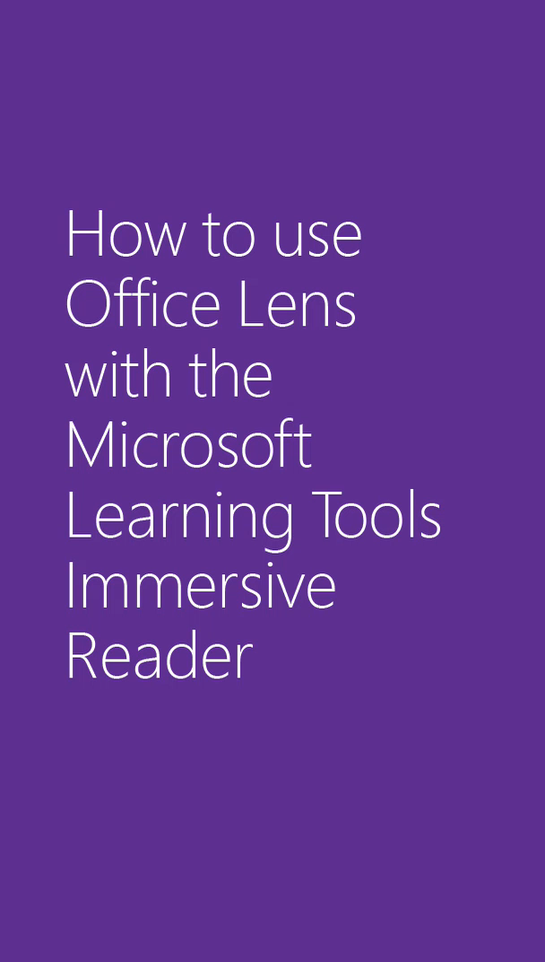
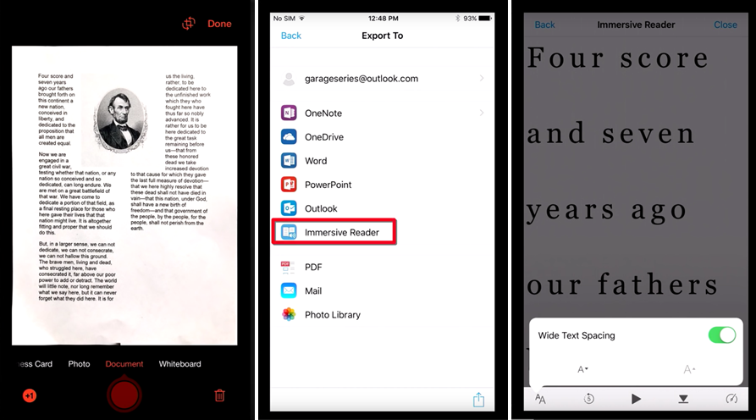
Organize Efficiently
Office Lens
OneNote, OneDrive, SharePoint
Outlook and MyAnalytics
Notes:
Office Lens, OneNote and OneDrive have all been enhanced to be more useful for those with visual impairments.
Office Lens helps users by utilizing orientation detection and column recognition to transform text on a printed page into searchable and readable content. To empower people with visual impairments to get an image of exactly what they’re trying to capture, we launched Frame Guide in Office Lens for iOS. Learn more at https://blogs.office.com/2016/11/10/immersive-reader-and-frame-guide-come-to-office-lens-offering-built-in-accessibility/
We recently updated the design of OneNote for Windows 10, Mac, iOS, Android and OneNote Online. In the new design, the navigation controls are all in one area on the left-hand side of the app. This allows users to easily switch between their notes and dramatically improves usability with assistive technologies. In addition, content is front and center—helping people to focus and avoid distractions. Learn more at https://blogs.office.com/2017/05/18/note-taking-made-easier-for-everyone-redesigning-onenote/
OneDrive makes it easy to access and share files using screen readers and keyboards, and offers a familiar experience to Windows file explorer users. Learn more at https://www.youtube.com/watch?v=of1BkNbFaPQ&list=PLXtHYVsvn_b-OyLfCR3M7djOLShKq7sBB&index=8

Slide 15
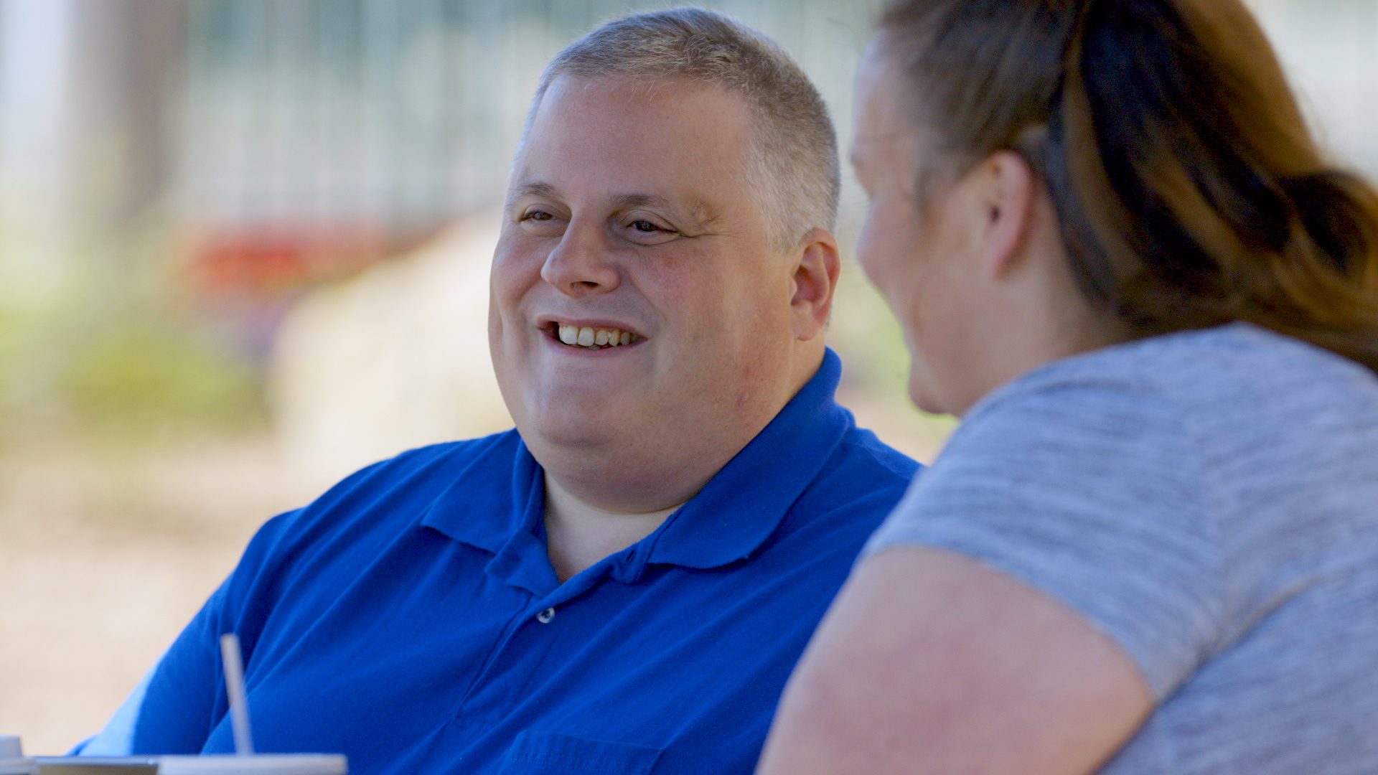
Steve’s Story
“I couldn’t be happier about what OneNote has enabled me to be able to accomplish, and I think that by making it accessible and by making it usable by all, what Microsoft has done is opened up limitless possibilities to people.”
Steve is a father who is blind and managed a medical crisis involving his young daughter, with OneNote and Office Lens by his side to make printed materials accessible.

Slide 16
Accessible Organization Tools in Office 365
Capability | Availability
Frame Guide for Office Lens | Office Lens for iOS
Immersive Reader for Office Lens | Office Lens for iOS
Efficient screen reader and keyboard experiences for OneNote | OneNote for Windows 10, Mac, iOS, Android and OneNote Online
Efficient screen reader and keyboard experiences for OneDrive | OneDrive on various platforms
Efficient screen reader and keyboard experiences for Outlook | Outlook on various platforms
Build better work habits with MyAnalytics | Outlook add-in and web Dashboard

Slide 17

Accessibility requires compliance and usability

Slide 18
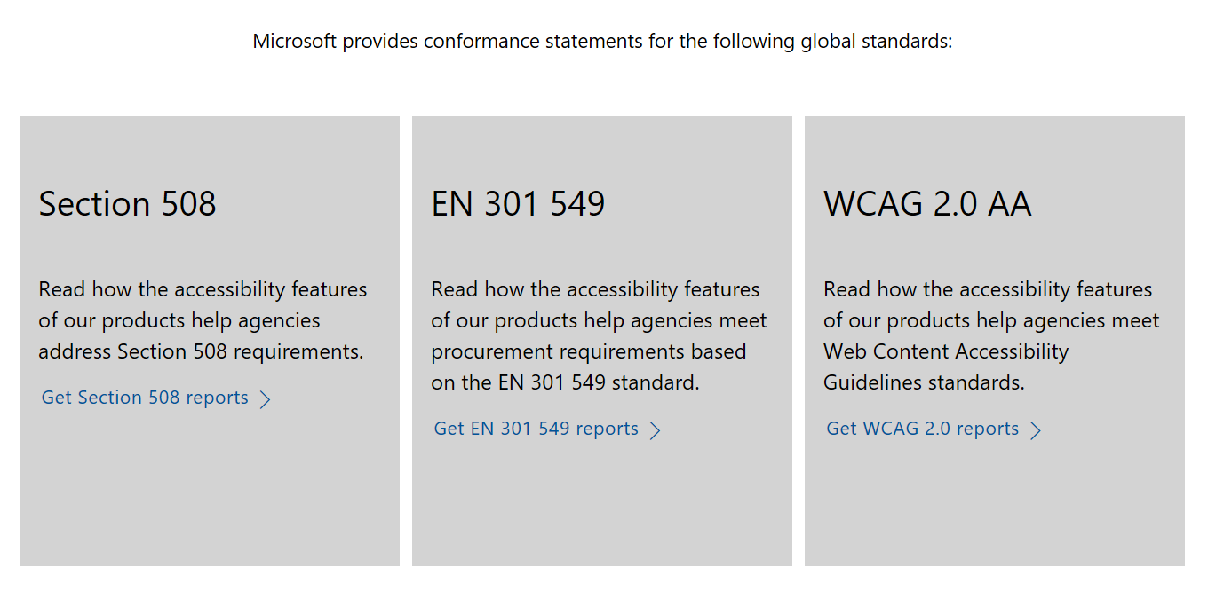
Office 365 is designed to meet global accessibility standards, conformance reported based on Trusted Tester inspections
Notes:
We’ve implemented a Trusted Tester program, in partnership with the U.S. Department of Homeland Security. This program makes technology evaluations easier. In addition to training employees about accessibility, we require all contracted accessibility testers to be certified Trusted Testers. So far 300 testers have been trained – and that’s just for Office. We will be continuing to expand this program.
These kinds of partnerships and scalable systemized processes, enable us to provide the latest conformance documentation for our products, saving our customers resources in the process, so they can make decisions with confidence and focus on what is best for their business, employees and customers.
Learning more in https://blogs.msdn.microsoft.com/accessibility/2017/02/20/supporting-enterprise-and-government-customers-with-accessibility-standards-conformance-testing-for-microsoft-products/

Slide 19
Learn more about Office 365 via Sessions in Seaport Ballroom H
3/21 11am: What’s New in Microsoft Office 365
3/22 8am: Strategies to Make your IT Applications More Accessible
3/22 11am: Create Inclusive Classrooms with Microsoft Education
3/22 1.20pm: Microsoft Reading, Writing and Learning Tools
3/22 3.20pm: Excel 101 Tips and Tricks
3/22 4.20pm: Easily create accessible content with Office 365
3/23 9am: Modernization of IT with SharePoint Accessibility
3/23 11am: Create Engaging and Accessible Presentations with PowerPoint and Sway
3/23 2.20pm: How I used Microsoft OneNote to Manage a Medical Crisis
3/23 4.20pm: Software Architecture in Office 365 for Exposing Accessible Content

Slide 20
Learn more about Office 365 via Demos in CSUN Expo Hall
3/21 12.30pm, 3/22 1pm & 3/23 12.30pm : Communicate inclusively with Office 365
3/21 2.30pm, 3/22 11am, 3/22 2.30pm, 3/23 11am & 3/23 1.30pm : Create more inclusive classrooms with Microsoft Education
3/22 10.30am & 3/23 10.30am: OneNote – screen reader tips and tricks
3/22 12.30pm: Read and write effectively with Learning Tools
3/22 1.30pm: Excel – screen reader tips and tricks
3/22 3pm: Write effectively with Editor

Slide 21
Additional Resources
Trainings and help articles on Office 365: Aka.ms/OfficeAccessibility
PowerPoint add-in for live subtitling: Aka.ms/PresentationTranslator
Tools to improve comprehension: OneNote.com/LearningTools
Dictate add-in for typing in Office with your voice: Dictate.ms
Office Lens app for scanning with OCR: Aka.ms/OfficeLens
Microsoft Accessibility Site Microsoft.com/Accessibility
Twitter for news, insights, and updates @MSFTEnable
Microsoft Presentations at CSUN Aka.ms/CSUN2018
Accessibility support for organizations Aka.ms/Edad

Slide 22
We want to hear from you.
Connect with us in person today or anytime through our support and feedback channels.
Disability Answer Desk for phone/chat/ASL Help: Aka.ms/AccessibilitySupport
User voice Forum for Accessibility Feedback: Aka.ms/AccessibilityFeedback

